Slide 1
MODULE 4

Slide 2
Apache TinkerPop
Apache TinkerPop is like a common platform (or bridge) for working with graph databases.
Provides a standard way to interact with different graph databases (like Neo4j, JanusGraph, Amazon Neptune)
You don’t need to learn a different API for each database
Supports:
OLTP → real-time queries (like finding friends of a user)
OLAP → large-scale analysis (like analyzing entire networks)

Slide 3
Gremlin (The Query Language)
Gremlin is the language used to query graph data in TinkerPop.
Helps you navigate through nodes (vertices) and connections (edges)
Works like SQL but for graphs
Example:
g.V().has('name', 'Alice').out('knows').values('name')

Slide 4
Groovy (The Scripting Language)
A programming language used to write Gremlin queries
Groovy is a dynamic programming language that runs on the Java platform.
Syntax is similar to Java, but shorter and easier
Used for scripting and automation
Runs on the JVM (Java Virtual Machine)
In graph databases, it is used in the Gremlin Console
Groovy is used to write Gremlin queries
Groovy is a simple scripting language on the Java platform used to write and execute Gremlin graph queries.

Slide 5
Neo4j | Gremlin
Node | Vertex
Relationship | Edge

Slide 6
Basic Commands
g.V()
all nodes
Get all edges
g.E()
Returns all relationships
Get specific node
g.v[0]

Slide 7

Create Graph
graph = TinkerGraph.open()
Creates a new empty graph database in memory
No data yet
0 nodes, 0 relationships

Slide 8

Create Traversal Object
g = graph.traversal()
Creates a traversal source
g is used to query the graph

Slide 9
Create Nodes (Vertices)
// 1. Create Alice and save her to a variable 'a'
a = g.addV('person').property('name', 'Alice').next()
// 2. Create Bob and save him to a variable 'b'
b = g.addV('person').property('name', 'Bob').next()

Slide 10
Create relationship(Edge)
// 1. Create Alice and save her to a variable 'a'
a = g.addV('person').property('name', 'Alice').next()
// 2. Create Bob and save him to a variable 'b'
b = g.addV('person').property('name', 'Bob').next()
// 3. Link them directly using the variables
g.V(a).addE('follows').to(b).iterate()

Slide 11
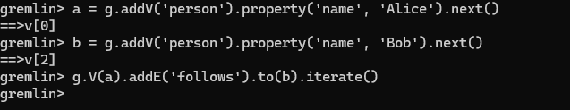

Slide 12
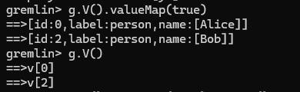
Display Vertices

Slide 13

Specific Node

Slide 14
Delete
g.V(): Selects all vertices.
.drop(): Deletes them.
.iterate(): Executes the command.
In Gremlin, you simply find every vertex and "drop" them. Since edges (relationships) cannot exist without vertices, deleting the nodes automatically deletes the relationships.

Slide 15
Use .next() if you need to use the result (the Node or Edge) in your next line of code.
Use .iterate() if you just want the database to "do the work and shut up" (common for creating links or bulk updates).

Slide 16
The Social Network Exercise
Nodes: Create 2 'person' nodes.
Node 1: Name it "Sam", add age 25 and city "New York".
Node 2: Name it "Alex", add age 30 and city "London".
Relations: Create a "friends" relationship from Sam to Alex.
Add two properties to this relationship: since (value: "2020") and strength (value: 5).

Slide 17
Gremlin (Groovy)
// Create Sam and Alex (using .next() to save them to variables)
sam = g.addV('person').property('name', 'Sam').property('age', 25).property('city', 'New York').next()
alex = g.addV('person').property('name', 'Alex').property('age', 30).property('city', 'London').next()
// Create the relationship with properties (using .iterate() to execute)
g.V(sam).addE('friends').to(alex).property('since', '2020').property('strength', 5).iterate()

Slide 18
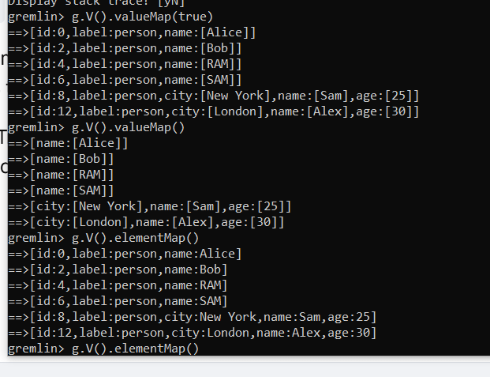

Slide 19
Display Sam
g.V().has('person', 'name', 'Sam').elementMap()
MATCH (p:person {name: 'Sam'})
RETURN p

Slide 20
Update Sam's Age
g.V().has('person', 'name', 'Sam').property('age', 26).iterate()
MATCH (p:person {name: 'Sam'})
SET p.age = 26

Slide 21
See Sam's Friends
g.V().has('person', 'name', 'Sam').out('friends').values('name')
MATCH (s:person {name: 'Sam'})-[:friends]->(f)
RETURN f.name

Slide 22
Remove the 'city' property from Sam
g.V().has('name', 'Sam').properties('city').drop().iterate()
MATCH (p:person {name: 'Sam'})
REMOVE p.city

Slide 23
Delete the "friends" link between Sam and Alex
g.V().has('name', 'Sam').outE('friends').where(inV().has('name', 'Alex')).drop().iterate()
g.V().has('name', 'Sam'): Start at the "Sam" node.
outE('friends'): Move from the node to the Edge (the arrow) labeled "friends." You are now standing on the line.
where(inV()...): While standing on that line, look at the node it is pointing into.
has('name', 'Alex'): Check if that "target" node is named "Alex."

Slide 24
Task 1: Create Graph Nodes (Vertices)
Create a graph database using Gremlin by defining the following entities as vertices:
A winery named “Prancing Wolf Winery”
Three wines:
“Prancing Wolf Ice Wine 2007”
“Prancing Wolf Kabinett 2002”
“Prancing Wolf Spatlese 2007”
One grape type named “Riesling”
Store each vertex in a variable for further use in graph construction.

Slide 25
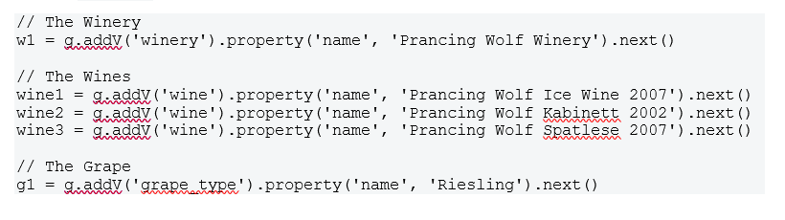

Slide 26
Task 2: Create Relationships (Edges)
Establish meaningful relationships between the vertices created in Task 1:
Connect the winery to all three wines using a relationship that represents production.
Connect the wines “Kabinett 2002” and “Spatlese 2007” to the grape type “Riesling” using a relationship that represents grape type association.
Ensure that edges correctly represent directional relationships in the graph.

Slide 27
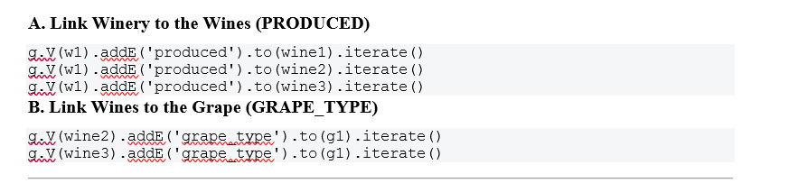

Slide 28
Task 3: Query the Graph
Write Gremlin traversal queries to retrieve the following information from the graph:
Retrieve all wines produced by “Prancing Wolf Winery”
Find the grape type associated with “Prancing Wolf Kabinett 2002”
List all wines that are associated with the grape type “Riesling”

Slide 29
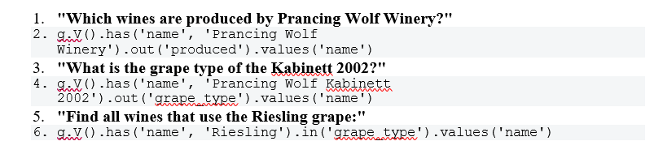

Slide 30
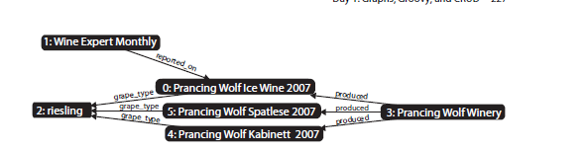
v[0] → Prancing Wolf Ice Wine 2007
v[1] → Wine Expert Monthly
v[2] → riesling
e[0] → (Wine Expert Monthly) -[reported_on]-> (Prancing Wolf Ice Wine 2007)

Slide 31
// 1. Filter riesling g.V.filter{it.name=='riesling'} ==> v[2] // 2. Outgoing edges of Wine Expert Monthly g.V.filter{it.name=='Wine Expert Monthly'}.outE() ==> e[0][1-reported_on->0] // 3. Move to vertex and get name g.V.filter{it.name=='Wine Expert Monthly'}.outE().inV().name ==> Prancing Wolf Ice Wine 2007 // 4. Using shortcut g.V.filter{it.name=='Wine Expert Monthly'}.out().name ==> Prancing Wolf Ice Wine 2007

Slide 32
// 1. Create Students
s1 = g.addV('Student').property('name','Alice').next()
s2 = g.addV('Student').property('name','Bob').next()
// 2. Create Course
c1 = g.addV('Course').property('name','DBMS').next()
// 3. Create Relationship (enrolled_in)
g.V(s1).addE('enrolled_in').to(g.V(c1))
g.V(s2).addE('enrolled_in').to(g.V(c1))
// 4. Using has() → find student Alice
g.V().has('name','Alice')
// 5. Using filter{} → find student Alice
g.V().filter{it.get().value('name')=='Alice'}
// 6. Find students enrolled in DBMS (using has)
g.V().has('name','DBMS').in('enrolled_in').values('name')
// 7. Same using filter{}
g.V().filter{it.get().value('name')=='DBMS'}
.in('enrolled_in').values('name')

Slide 33
g.addV('Student').property('name','Alice')
g.V().has('name','Alice').
addE('enrolled_in').
to(g.V().has('name','DBMS'))
g.V().has('name','Alice')
Alice --enrolled_in--> DBMS
Bob --enrolled_in--> AI
Which course is Alice studying?
g.V().has('name','Alice')
.out('enrolled_in')
.values('name')
Who are studying DBMS?
g.V().has('name','DBMS')
.in('enrolled_in')
.values('name')

Slide 34
Alice --enrolled_in--> DBMS
Bob --enrolled_in--> AI
Charlie --enrolled_in--> DBMS
Find students whose name is Alice”
g.V().filter{it.get().value('name') == 'Alice'}

Slide 35
Alice --enrolled_in--> DBMS
Bob --enrolled_in--> AI
g.E()
e[1][Alice-enrolled_in->DBMS] e[2][Bob-enrolled_in->AI]
What relationships does Alice have
g.V().has('name','Alice').outE()
Show full relationship of Alice
g.V().has('name','Alice')
.outE()
.inV()
.values('name’)
OR
g.V().has('name','Alice')
.outE('enrolled_in')
.values('since')

Slide 36
Alice --enrolled_in--> DBMS
Bob --enrolled_in--> AI

Slide 37
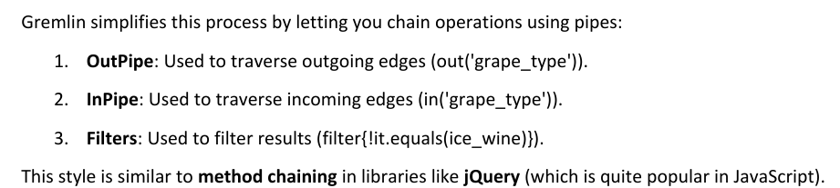
Pipes
In Gremlin, every query is a chain of steps (pipes).
Each step:
Takes input
Processes it
Passes output to next step
This chain is called a Traversal (modern term instead of “pipeline”)

Slide 38
PIPE EXAMPLE
g.V().has('name','Ice Wine')
.out('grape_type')
.in('grape_type')
.where(neq('Ice Wine'))
.values('name')
g.V() → all vertices
has() → filter Ice Wine
out('grape_type') → go to grape
in('grape_type') → find other wines
where() → remove original wine
values('name') → get names

Slide 39
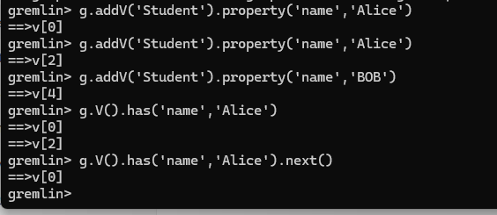
Pipeline vs Vertex
Pipeline
g.V().filter{it.name=='Alice’}
Output:
Not a single node
It is a pipeline (list/stream of results)
Vertex
g.V().filter{it.name=='Alice'}.next()
One actual vertex (Alice)
Without .next() → list (pipeline)
With .next() → single element
Pipeline (Traversal) = flow / collection of results (like a list)
Vertex = one single node
.next() = takes one element from pipeline

Slide 40
Pipe in Gremlin?
A pipe is just a step in a query that processes data and passes it to the next step.
g.V().has('name','Alice').out('enrolled_in').values('name’)
Pipes/Steps
Step | Meaning
g.V() | get all vertices
has('name','Alice') | filter
out('enrolled_in') | move
values('name') | display
Pipe = single operation Pipeline = sequence of operations
All together = Pipeline

Slide 41
Schemaless Graph
Adding new types of nodes and relationships WITHOUT changing any schema (structure)
Alice and her preference
alice = g.addV('Person').property('name','Alice')
ice_wine = g.V().has('name','Prancing Wolf Ice Wine 2007').next()
g.V(alice).addE('likes').to(ice_wine)

Slide 42
Schemaless Graph
Adding new types of nodes and relationships WITHOUT changing any schema (structure)
Tom and his preferences
tom = g.addV('Person').property('name','Tom')
kabinett = g.V().has('name','Prancing Wolf Kabinett 2002').next()
g.V(tom).addE('likes').to(kabinett)
g.V(tom).addE('likes').to(ice_wine)
g.V(tom).addE('trusts').to(g.V().has('name','Wine Expert Monthly').next())

Slide 43
Schemaless Graph
Adding new types of nodes and relationships WITHOUT changing any schema (structure)
Add Patty (social connection)
patty = g.addV('Person').property('name','Patty')
g.V(patty).addE('friends').to(tom)
g.V(patty).addE('friends').to(alice)
We added new relationships (likes, trusts, friends) WITHOUT modifying existing structure

Slide 44


Domain-Specific Step
A custom step (method) you create in Gremlin so queries become easy to read like English
In earlier versions of Gremlin (TinkerPop 2), users could define custom traversal steps
using Gremlin.defineStep().
This allowed developers to create reusable shortcuts for frequently used traversal patterns.
For example, instead of repeatedly writing a traversal like:
.out('enrolled_in’)
a custom step such - .course()
Earlier versions allowed custom steps, but modern Gremlin uses direct traversals instead.

Slide 45
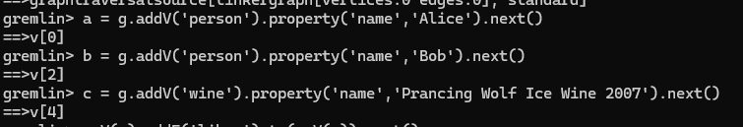


Update Delete
Store the edge and update

Slide 46


Update Delete
Update vertex property
Delete property, edge, and vertex

Slide 47
REST API Refer word document

Slide 48
CQL REF LAB DOCUMENT

Slide 49
Types of Indexing
Exact Match Index (Key-Value / Hash Index)
This is the simplest and most common type
Works like a key → value lookup
Finds nodes based on exact property value
CREATE INDEX FOR (p:Person) ON (p.name);
MATCH (p:Person {name: "Alice"})
RETURN p;
"Alice" must match exactlyFast lookup using index

Slide 50
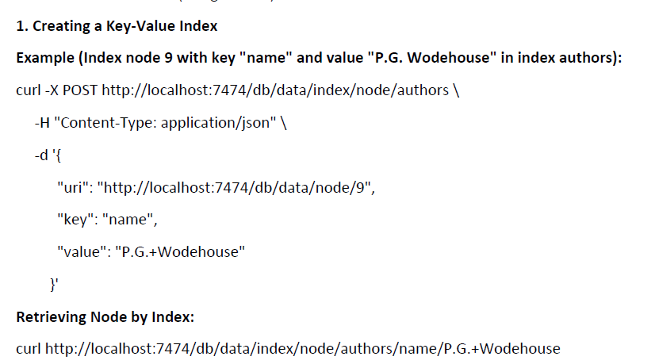
Types of Indexing
Exact Match Index (Key-Value / Hash Index)
Using REST

Slide 51
Types of Indexing
Full-Text Index
Used for searching text (not exact match)
Works like Google search
Supports:
partial match
case-insensitive search
similar words

Slide 52
Types of Indexing
Full-Text Index
CALL db.index.fulltext.createNodeIndex( "personIndex", ["Person"], ["name"] );
Query:
CALL db.index.fulltext.queryNodes("personIndex", "Ali")
YIELD node
RETURN node;

Slide 53
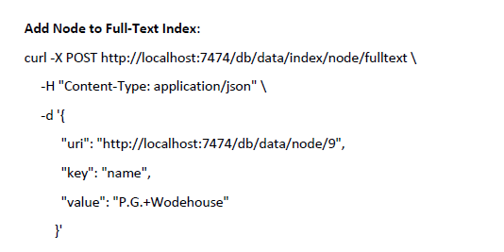
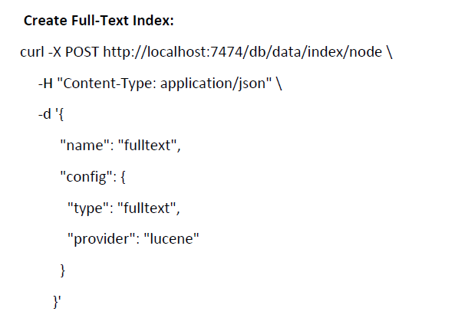

Types of Indexing
Full-Text Index

Slide 54
Path Finding in Neo4j
Path finding means: finding how one node is connected to another node through relationships
Example:
Alice → wrote → Book → published by → Publisher

Slide 55
Path Finding in Neo4j
Example
curl -X POST http://localhost:7474/db/data/node/9/paths \
-H "Content-Type: application/json" \
-d '{
"to":"http://localhost:7474/db/data/node/10",
"relationships": {"type" : "WROTE"},
"algorithm":"shortestPath",
"max_depth":10
}'
OUTPUT
start → node9
nodes → [node9, node10]
length → 1
relationships → [WROTE]
end → node10
Field | Meaning
to | Target node
relationships | Type of edge to follow
algorithm | Path algorithm
max_depth | How far to search

Slide 56
Path Finding in Neo4j?
Path Algorithms
shortestPath
Finds minimum steps path
allPaths
Finds all possible paths
allSimplePaths
Finds paths without repeating nodes
dijkstra
Finds shortest weighted path (if weights exist)

Slide 57
Neo4j High Availability (HA)
High Availability (HA) means:
Neo4j runs on multiple servers (cluster)
If one server fails, others still work
System stays always available

Slide 58
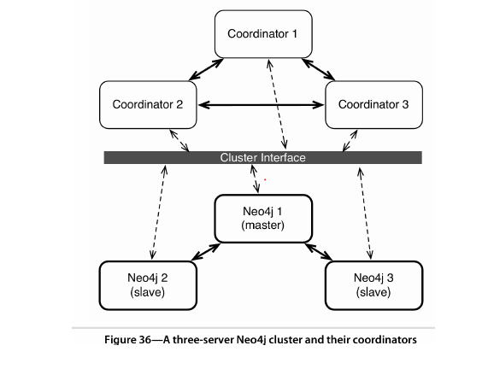
Neo4j High Availability (HA)

Slide 59
Neo4j High Availability (HA)
Neo4j 1 (Leader/Master) → Handles all write operations
Neo4j 2 & Neo4j 3 (Followers/Slaves) → Handle read operations and copy data from leader
ZooKeeper-Coordinator 1, 2, 3 → Act as request managers
Receive queries from clients
Send writes to leader and reads to followers
Controls the cluster
Decides who is master
Keeps nodes in sync
Cluster Interface → Connects coordinators with database servers

Slide 60
Server setup and cluster configuration commands for Neo4j HA
# 1. Extract and create 3 Neo4j instances tar fx neo4j-enterprise-1.7-unix.tar mv neo4j-enterprise-1.7 neo4j-enterprise-1.7-1 cp -R neo4j-enterprise-1.7-1 neo4j-enterprise-1.7-2 cp -R neo4j-enterprise-1.7-1 neo4j-enterprise-1.7-3 # 2. Set ZooKeeper IDs echo "1" > neo4j-enterprise-1.7-1/data/coordinator/myid echo "2" > neo4j-enterprise-1.7-2/data/coordinator/myid echo "3" > neo4j-enterprise-1.7-3/data/coordinator/myid

Slide 61
Server setup and cluster configuration commands for Neo4j HA
# 3. ZooKeeper configuration (coord.cfg shared) server.1=localhost:2888:3888 server.2=localhost:2889:3889 server.3=localhost:2890:3890 # Client ports # Server 1: 2181 # Server 2: 2182 # Server 3: 2183 # Start ZooKeeper coordinators bin/neo4j-coordinator start

Slide 62
Server setup and cluster configuration commands for Neo4j HA
# 4. Neo4j HA configuration (in neo4j-server.properties) org.neo4j.server.database.mode=HA org.neo4j.server.webserver.port=7471 # 7472, 7473 for others org.neo4j.server.webserver.https.port=7481 # 7482, 7483 # 5. Neo4j HA configuration (in neo4j.properties) ha.server_id=1 # change to 2, 3 for other nodes ha.coordinators=localhost:2181,localhost:2182,localhost:2183 ha.server=localhost:6001 # 6002, 6003 for others ha.pull_interval=1 # 6. Start Neo4j servers bin/neo4j start # 7. Check logs tail -f data/log/console.log

Slide 63
Transactional Modes in Gremlin
Gremlin supports transactions to ensure graph operations are safe and consistent.
A transaction = a group of operations treated as one unit.
If everything works → changes are saved (COMMIT)
If error occurs → changes are cancelled (ROLLBACK)

Slide 64
Transactional Modes in Gremlin
Manual Transaction Mode
In this mode, you control when transaction starts and ends.

Slide 65
Transactional Modes in Gremlin
g.setTransactionMode(TransactionalGraph.Mode.MANUAL)
g.startTransaction()
try {
// Example graph operations
g.addVertex([name:'Alice'])
g.addVertex([name:'DBMS'])
g.addEdge(g.v(0), g.v(1), 'enrolled_in')
// If everything is successful
g.stopTransaction(TransactionalGraph.Conclusion.SUCCESS)
} catch(e) {
// If any error occurs, rollback changes
g.stopTransaction(TransactionalGraph.Conclusion.FAILURE)
}
Manual Transaction Mode

Slide 66
Neo4j and CAP Theorem
CAP theorem explains how distributed databases behave when there is a network issue.
CAP =
C → Consistency (all nodes show same data)
A → Availability (system always responds)
P → Partition Tolerance (system works even if network breaks)

Slide 67
Neo4j and CAP Theorem
Neo4j HA = AP System
Neo4j High Availability mainly follows:
Availability
System is always available
You can still read/write even if some nodes fail
Partition Tolerance
Works even if network between nodes breaks

Slide 68
Neo4j and CAP Theorem
Consistency
Neo4j sacrifices strong consistency
Slave nodes may have slightly old data
Data becomes consistent after some time
In Neo4j High Availability:
One node acts as master (writer)
Others are slaves (readers)
Updates are propagated asynchronously
So data is not updated everywhere instantly.
Step 1: Alice = "DBMS" (updated at master)
Step 2:
Slave A → updated
Slave B → still shows old value

Slide 69
Key Points of Neo4j High Availability (HA):
1. Cluster of Multiple Nodes:
HA uses a cluster of Neo4j servers (at least 3) to ensure continuous service.
2. Master-Slave Architecture:
One node is elected as master, others are slaves. Writes go to the master, reads can be
served by any node.
3. Automatic Failover:
If the master node fails, another node is automatically elected as the new master.
4. Data Replication:
Changes made on the master are replicated to all slaves.
5. Zookeeper for Coordination:
Neo4j 1.7 uses Zookeeper (coordinator) to manage leader election and cluster
communication.
6. HA Ensures Fault Tolerance:
Even if one or two nodes fail, the database stays available.
7. Scalable Reads:
Since read requests can go to slaves, it helps with load balancing and scaling.
8. Backup Support:
You can take full and incremental backups from the HA cluster safely.

Slide 70
Neo4j’s Strengths:
1. Flexible Data Model:
Typeless and schemaless, ideal for unstructured data.
No constraints on how data is related — fully dynamic relationships.
2. Massive Scale:
Supports up to 34.4 billion nodes and relationships.
3. Fast Traversals:
Graph traversals are constant time, unlike joins in RDBMS or MapReduce.
4. Useful Tools:
Built-in Lucene indexing, REST API, and Gremlin support.
5. Efficient Relationship Navigation:
If two nodes are related, jumping from one to the other is always one step, regardless of graph size.
6. High Availability Support (Enterprise Edition):
Ideal for read-heavy applications with failover and replication.

Slide 71
Neo4j’s Weaknesses:
1. No Self-Loops in Edges:
A node cannot have a direct relationship to itself.
2. Confusing Terminology:
Uses "node" and "relationship" instead of standard graph terms like vertex and
edge.
3. Replication Only (No Sharding):
HA supports only full graph replication, no subgraph sharding, limiting scalability.
4. Licensing Restrictions:
Community Edition is GPL, Enterprise Edition requires a paid license for features like HA and backups.

